Slide 1
Thinking Like Economist

Slide 2
How Do Economists study the Economy?
Economics is a social science that uses scientific method.
This is accompanied by the use of Economic Models that focus on specific relationships in the economy.
In order to create these models, Economists make many simplifying Assumptions.
This approach helps identify the key relationships that drive the economic decisions that we are interested in exploring.
In this chapter we are trying to understand how economists approach their discipline and tools they use.

Slide 3
Ceteris Paribus
Ceteris Paribus is the concept under which economists examine a change in one variable while holding everything else constant.
Example: Law of Demand explains ceteris paribus when the Price increases the demand for the commodity decreases.
Quantity demand can be influenced by income, price of related goods, taste and preferences and many other factors.

Slide 4
The Role of Assumptions
Economists make assumptions. Assumptions can simplify the complex world and make it easier to understand.
Example: Theory of Comparative Advantage
Assumptions Only 2 countries in the world and 2 goods are produced.

Slide 5
Economic Models
Model 1: Circular Flow Diagram
This diagram is a schematic representation of the organization of the economy.
Decisions are made by households and firms.
Households and firms market for goods and services and in the markets for factors of production.
The outer set of arrows shows the flow of money/dollars and the inner set of arrows shows the corresponding flow of inputs and outputs.

Slide 6
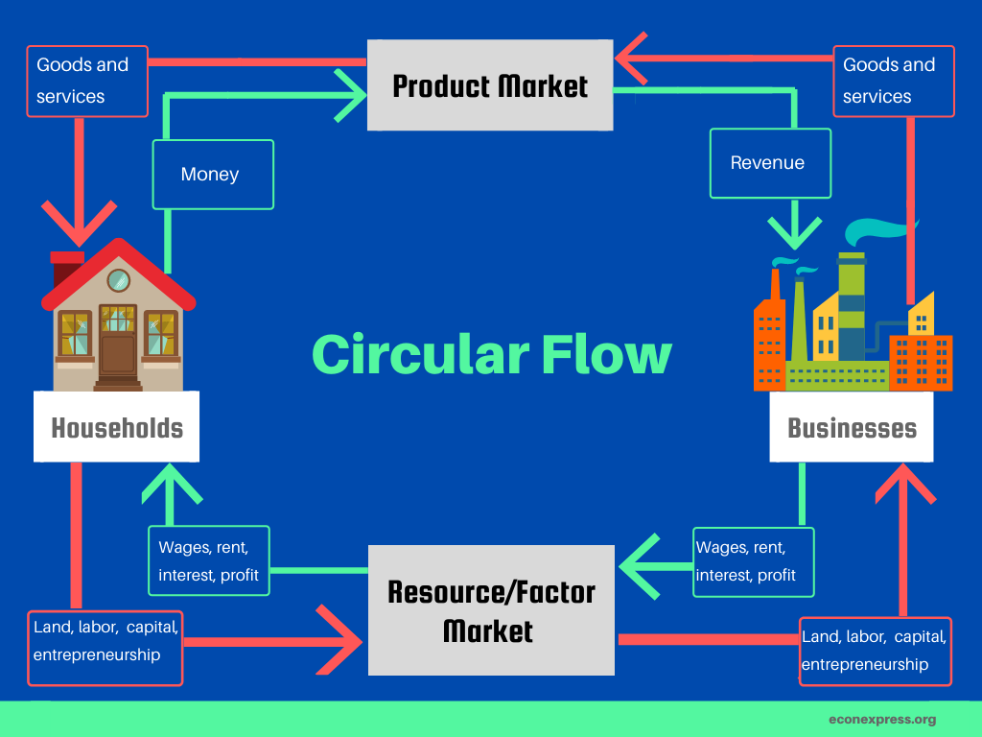

Slide 7
Maruti 3.0
Maruti Suzuki India is kicking off Maruti 3.0 targeting to add another 20 lakh units production capacity in nine years with about 28 different models.
It took 40 years to create capacity of 2 million units and Suzuki Motor Corporation helped in this process by establishing Gujarat Facility.
SUV sales gain momentum in India with limited demand for small entry level cars.
Steps taken by the company to meet future demand. Possible structural reorganisation
Maruti Suzuki expects the demand for exports to continue to grow and export 7.5 lakh to 8 lakhs by FY 2031.

Slide 8

Ferrari
A Prancing Horse
2019 was the first year that Ferrari shipped over 10,000 vehicles.
Ferrari’s total production from 1947 – 2019 was approximately 222,000 vehicles.
Ferrari has sold around 4.5% of its cars since 1947, alone in 2019 alone!

Slide 9
Why few Ferrari’s are made every year?
Ferraris are made with exceptional care, and almost entirely by hand.
The only part of the Ferrari manufacturing process that’s automated is the connection of each vehicle’s valve mechanics.
Engines are assembled by hand every day.

Slide 10
Inputs and Outputs
Inputs are commodities that are used to produce goods and services.
An economy is using its existing technology to combine inputs to produce outputs.
Outputs are the various useful goods and services that result from the production process and are either consumed or employed in further production.

Slide 11

Inputs and outputs in Pizza making
Eggs
Flour
Heat
Pizza oven
Chef’s skilled labour
Output-Tasty Pizza

Slide 12

Inputs and Outputs in Education System
Time of the Faculty and students
The laboratories
Classrooms
Textbooks …
Outputs are informed, productive, and well-paid citizens.

Slide 13
Factors of Production
Land: Natural resources-represents the gift of nature to our societies.
Land
Energy
Non energy resources like copper and iron ore and sand.
Labour: consists of human time in production. Working in automobile factories, writing software, teaching school or baking pizzas.
Capital: The durable goods of an economy are produced in order to produce yet other goods. Capital goods include machines and buildingss, roads, computers, steel mills, washing machines, and trucks.

Slide 14
Model 2: Production Possibility Frontier (PPF)
A graph shows the combinations of output that the economy can possibly produce given the available factors of production and the available production technology.
PPF shows combinations of output-cars and computers
The economy can produce on or inside the frontier.
Points outside the frontier are not feasible given the economy’s resources.

Slide 15
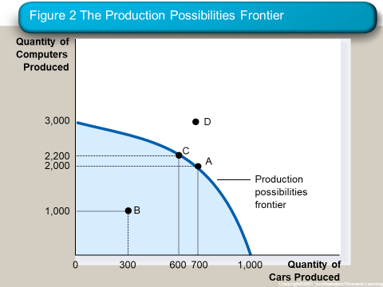

Slide 16
Production Possibility Frontier and Principles
Trade off
Scarcity
Efficiency
Opportunity Cost
Economic Growth

Slide 17
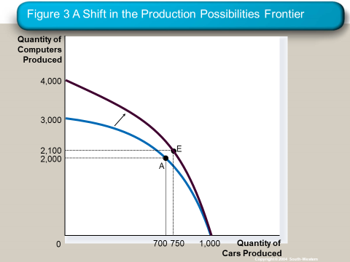

Slide 18
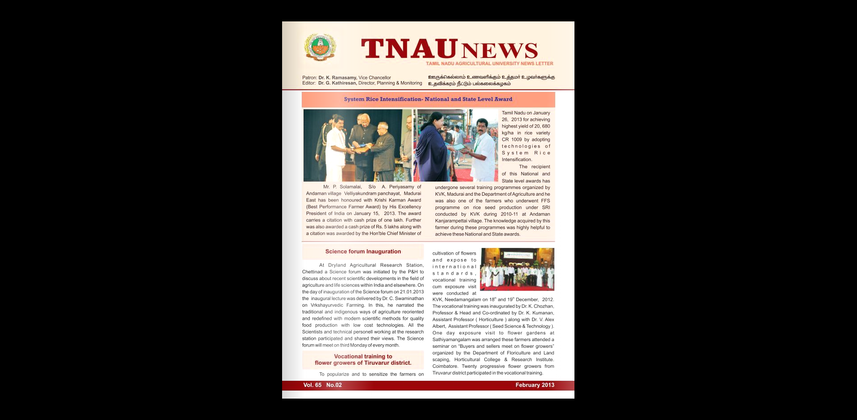

Slide 19
A Shift in the Production Possibility Frontier(PPF)
A technological advance in an industry enables the country to produce more commodities for any given number of another commodity.
Example: System of Rice Intensification
Mr. Solaimalai, who owns two hectares of land and had leased another two hectares in Andaman village in Madurai district, had set a record by producing 13,787 kilograms/ha of rice (or 20,680 kilo/ha of paddy) during the 2011-12 kharif season.
Techniques such as land levelling, use of bio-fertilisers and organic manure in the paddy variety – CR 1009 – had ensured the highest yield for the winner. In the previous season,
Last year yield- harvested 8,125 kilos of paddy per hectare.

Slide 20
Micro Economics Vs Macro Economics
Micro Economics
Adam Smith is considered as the founder of field of Micro Economics.
Branch of Economics concerned with the behaviour of individual entities such as markets, firms and households.
Concerned with the decisions made by individual economic units, consumers, workers, investors, owners of resources and business firms.
It is also concerned with the interaction of consumers and firms to form markets and industries.
Effect of Rent Control on Housing in Mumbai City
Macro Economics
John Maynard Keynes published his revolutionary book of General Theory of Employment, Interest and Money in 1936.
Concerned with overall performance of the economy.
It deals with aggregate economic variables, such as the level and growth rate of national output, interest rates, unemployment and inflation.
Unemployment Rate in Indian Economy

Slide 21
Positive Analysis
A positive statement can be tested and validated.
It explains “What it is”
Example: The unemployment rate is 7.0 %
Economics uses Positive Analysis.
Normative Analysis
A Normative statement is an opinion that cannot be tested or validated.
It explains “What ought to be”
Example: an unemployed worker should receive financial assistance to help make ends meet.

